Slide 1
Mobile App Development Team - 18
Notes:
1. Good afternoon everyone, we are team 18, now it’s our turn.

Slide 2
Leader: Linrong Jin
Member: Fuming Xiang
Member: Zhen Song

Slide 3

What is the song’s name ?
I don’t know
the name of it
-- People who heard the song
Notes:
In our daily life.
Some people who heard the song are not able to bethink the name of it.

Slide 4

What are you talking about ?
There are many dialects in China.
What are you talking about ?!?!?!
--Traveler
Notes:
It is difficult for some traveler when they talk with the local citizen with dialect.

Slide 5
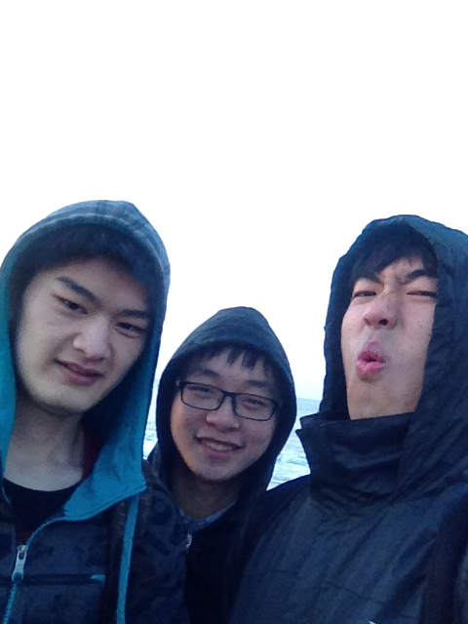
Help-by-Voice
Notes:
So, we plan to solve this problem with the App
Help-by-Voice.

Slide 6
Help-by-Voice
This APP is arming at
The people who have the impression of songs but cannot make determination
The people who are meeting with the problems of dialect which are only able to be solved by the local citizen in traveling or on business
Notes:
This APP is arming at
The people who have the impression of songs but cannot make determination
Or
The people who are meeting with the problems of dialect which are only able to be solved by the local citizen in traveling or on business
So we designed three scenarios for this App.

Slide 7
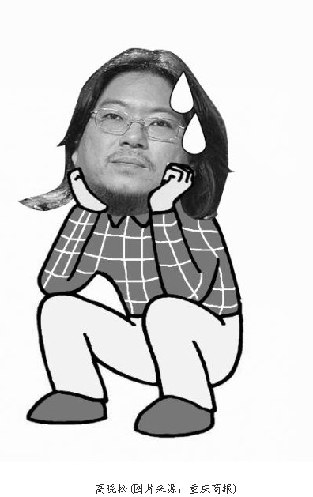
Scenario 1
——In campus
Walking with my roommate
and hear a song I have heard.
But the name is ……..
Notes:
Let’s see the first scenario:
I’m walking in the campus with my roommate. The campus radio is playing a nice song I have heard, but I forget its name. I ask to my roommate,” Have you ever heard this song? What’s its name?” My roommate shakes his head, turn on the phone and open an app and hum the melody of the song with memory.

Slide 8
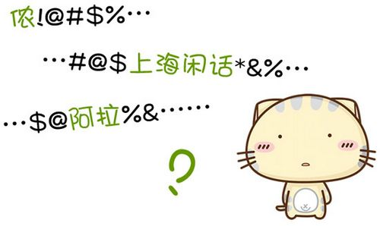
Scenario 2
——Hostfamily in Shanghai
How to say Hello in
Shanghainese ?????
Notes:
Here is the second scenario： （转方言）
I am an exchange student from America to Shanghai. I will live in the host family in Shanghai. I want to say hello to the family members in Shanghainese. So I use my smartphone to learn Shanghainese. So I open the app and put my question on the app.

Slide 9
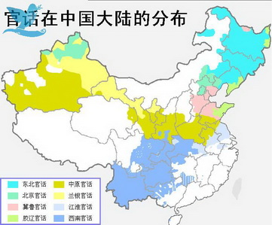
Scenario 3
——In traveling
What’s the meaning of “gaha”
Notes:
The last scenario： （方言转普通话）
In the summer travel, I heard a word of dialect accidentally and felt very interesting, but I don‘t know what it means, so I intend to use the software to ask for help from web friend to solve my confusion. I grab my phone and turned on the software. Put my question in.

Slide 10
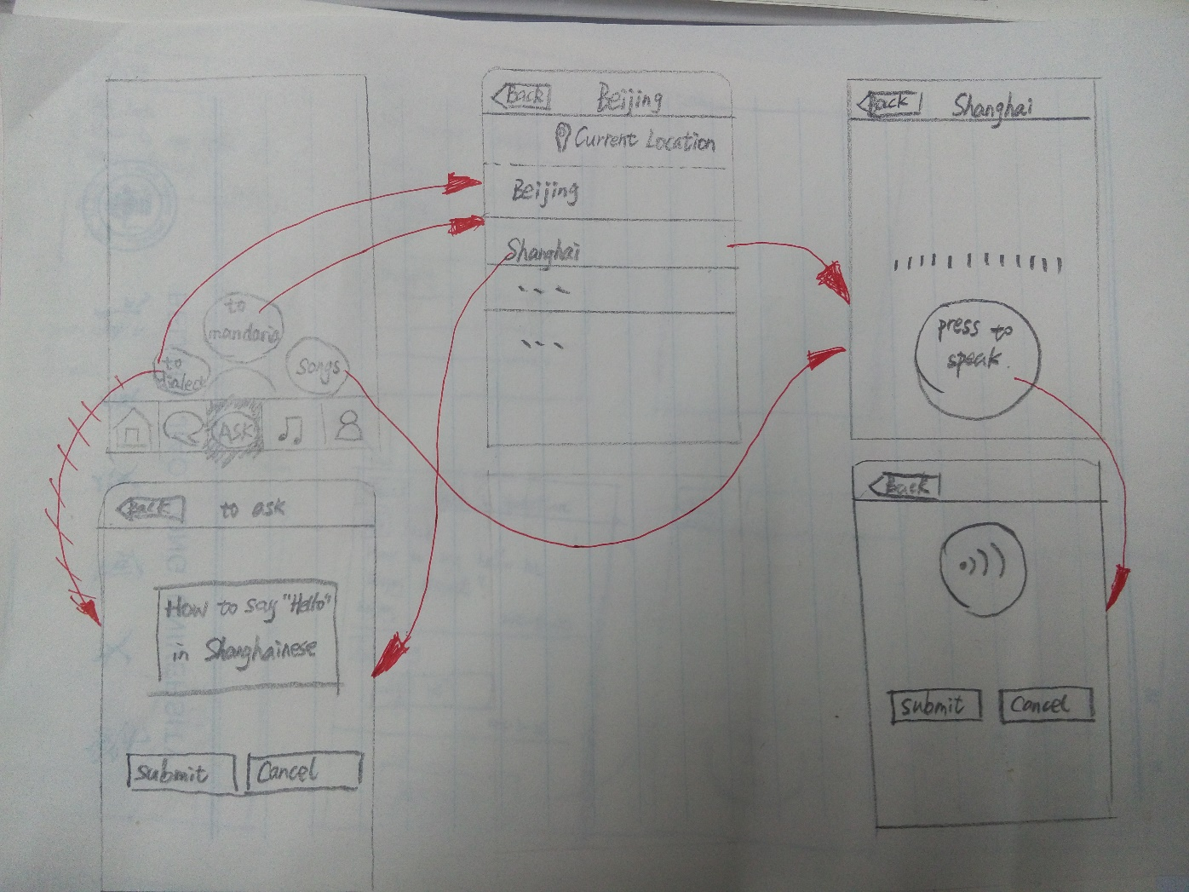
Use Case overview
Notes:
According to the scenarios, we designed our app. And next is the use case overview of our app. As this sketch shows, users can ask three kinds of questions in our app.

Slide 11
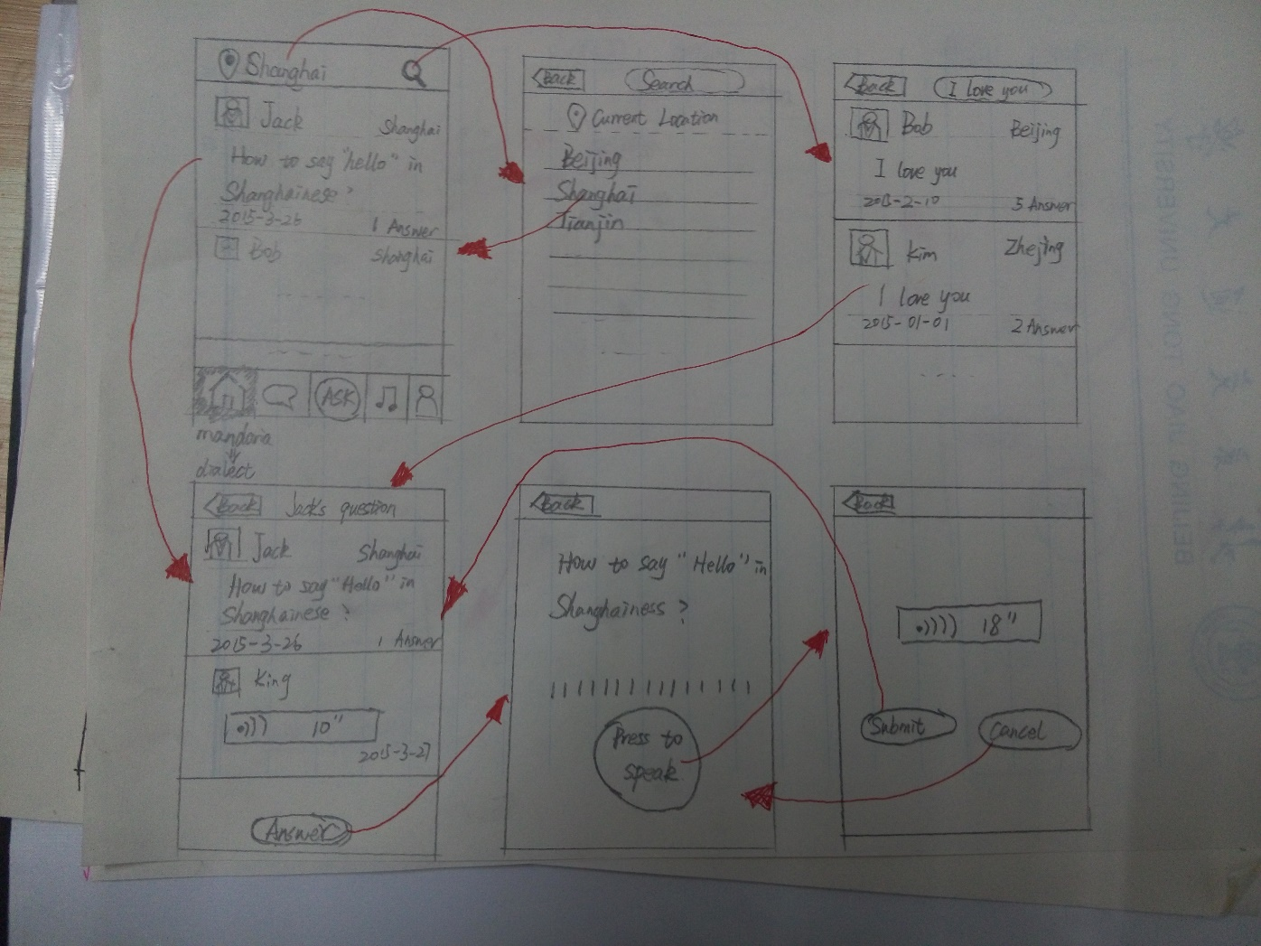
Use Case overview
Notes:
And then this sketch describes the function of querying and solving the problem that translating mandarin to dialect. Users can choose a question to see other users’ answers and if he know the answer, he can submit his answer by voice.

Slide 12
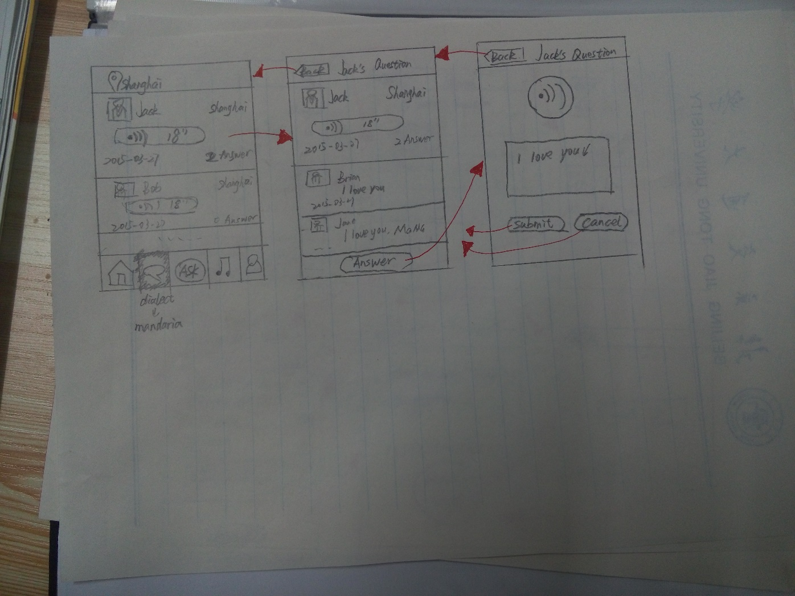
Use Case overview
Notes:
This sketch shows the function of querying the questions that translating dialect to mandarin. The questions should be sounds and the answers are words.

Slide 13
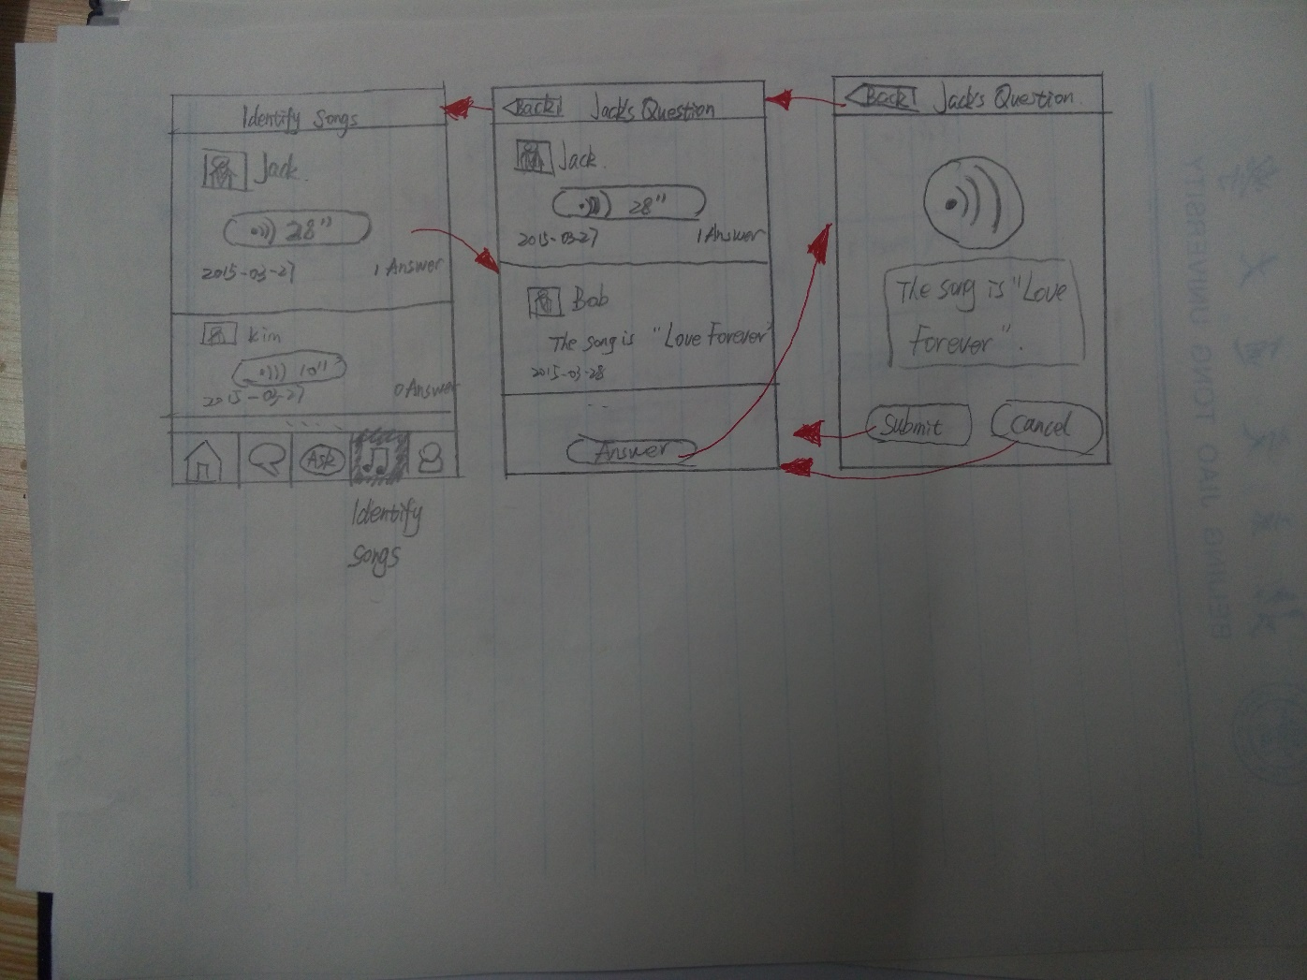
Use Case overview
Notes:
This sketch shows the function of querying the questions that identify the songs. As same as the former use case, the question is some melodies of a song.

Slide 14
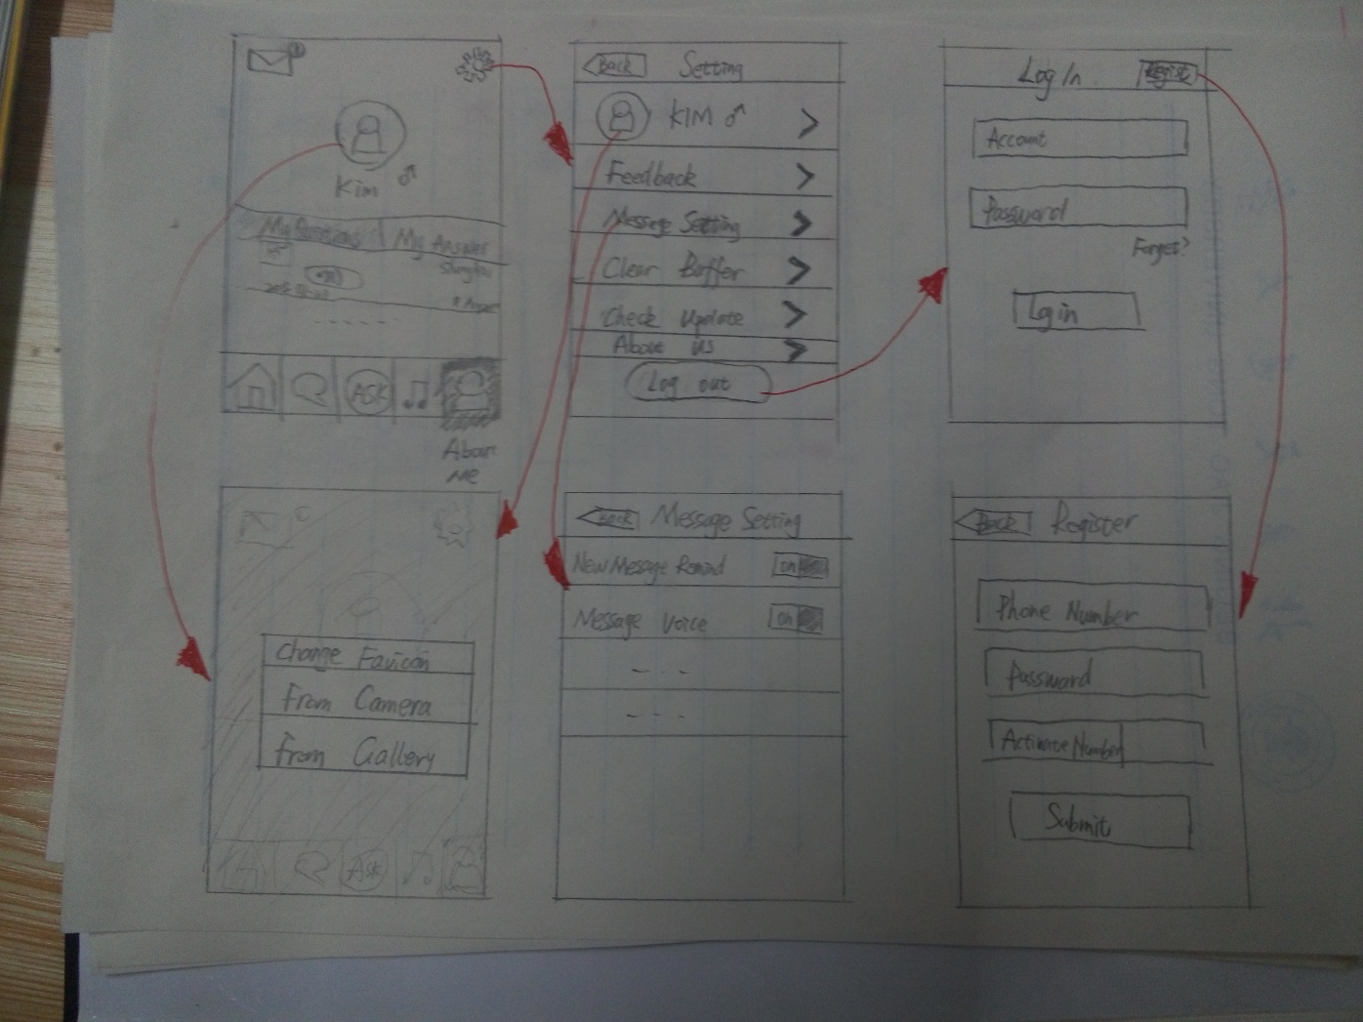
Use Case overview
Notes:
The last sketch is about account setup and personal settings.

Slide 15
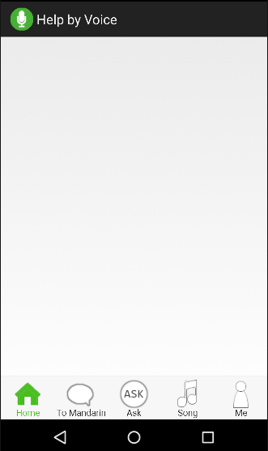
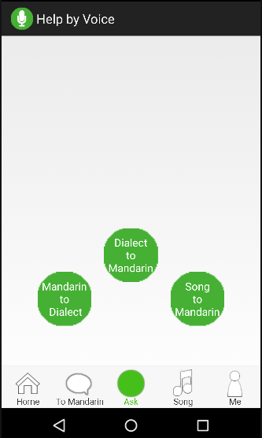
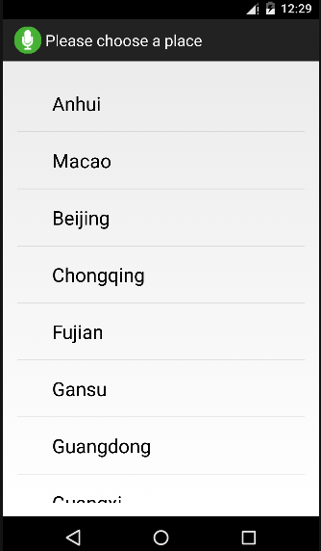
Prototype Demonstration
Translate mandarin to dialects
Notes:
After design, we developed a prototype to demonstrate the concept for our mobile app design. I want to describe our prototype by the use case translating mandarin to dialects. The first picture is the home page of our app. If we want to ask, we can click the ask button. Then click the button mandarin to dialect, go the place choose page.

Slide 16
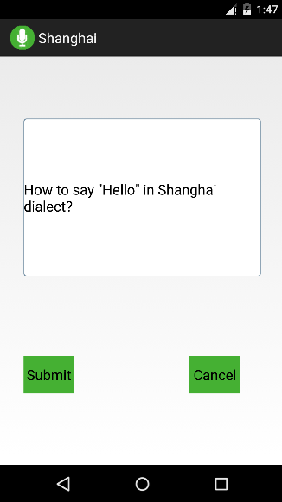
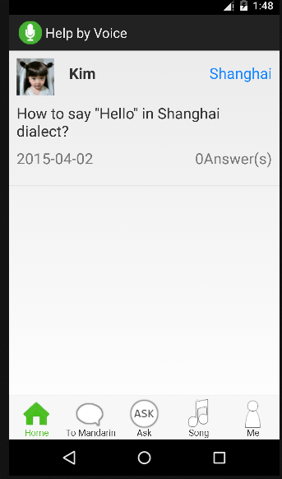
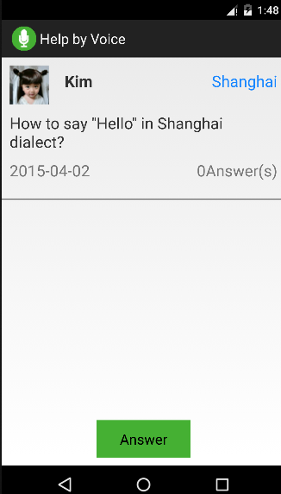
Prototype Demonstration
Translate mandarin to dialects
Notes:
We choose Shanghai. Then we can ask questions. After submitting, the app turns to the home page and we can see the question on it. Enter the question, there is no answer. The other user can click the answer button to answer.

Slide 17
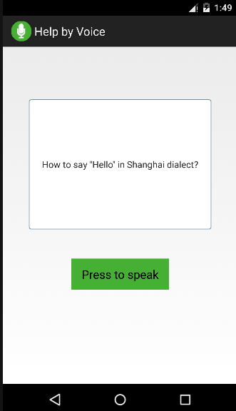
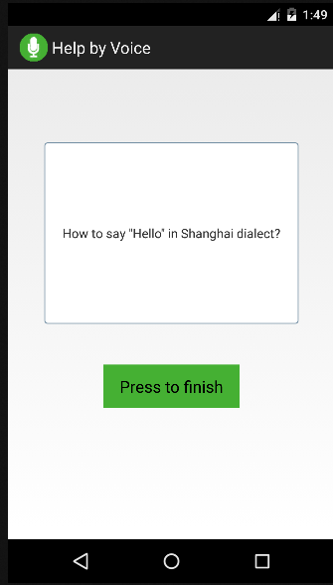
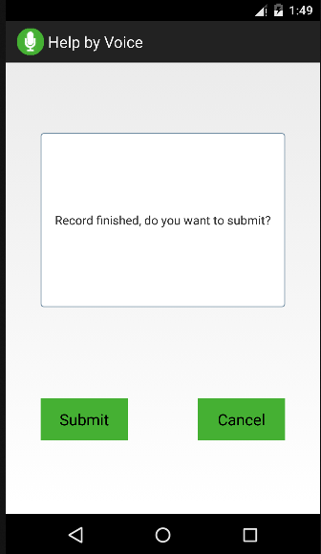
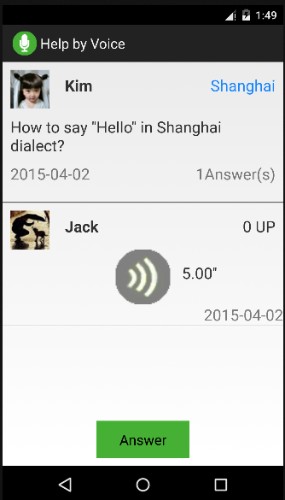
Prototype Demonstration
Translate mandarin to dialects
Notes:
When I click this button, the app will record the user’s voice. Finish, submit. We can see the answer in the question page. When we click the item, 宋震说说，Click the item，宋震说话。That’s the use case translating mandarin to dialects.

Slide 18


What to do next ?
——To add a server
OR
Notes:
We make a plan about the next development of our app. There are four main steps. First, we want to add a server. The app communicates with the server.

Slide 19
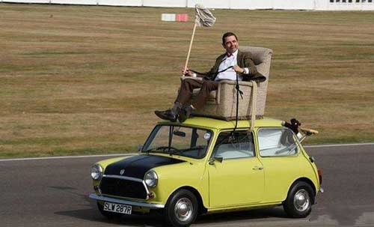
What to do next ?
——Improve the functions
Notes:
Second, improve the functions. For example, sort the answers according to the users’ praise.

Slide 20
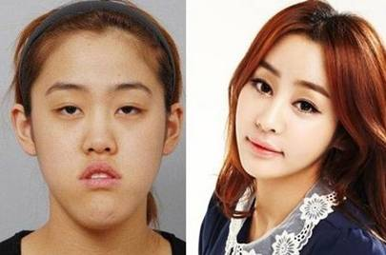
What to do next ?
——To beautify the UI
UI is very
important
Notes:
Third, to beautify the UI.

Slide 21

What to do next ?
——To publish our app to the google play

Slide 22
Thank you

